Slide 1

WORLD POPULATION
Sathana.R

Slide 2
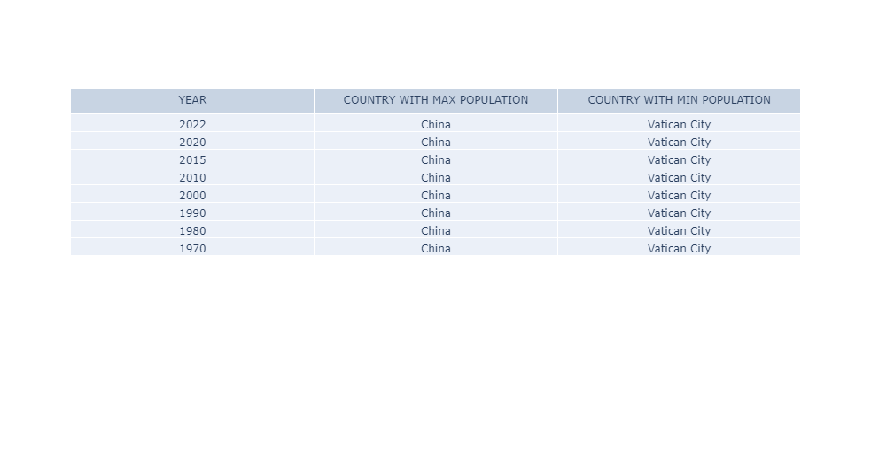
POPULATION

Slide 3
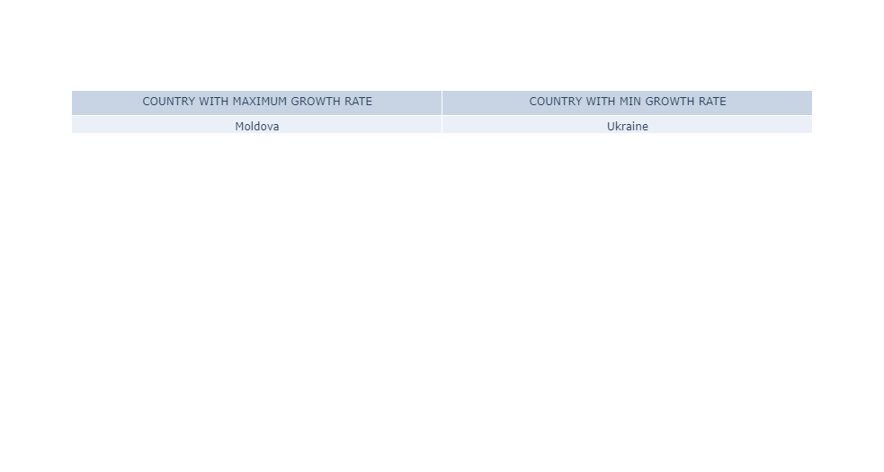
Growth rate

Slide 4
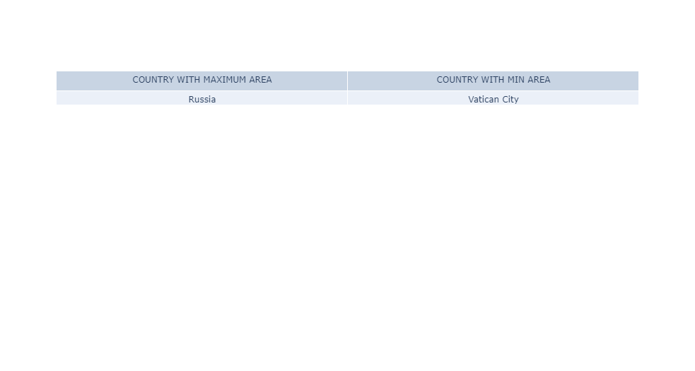
Area

